Slide 2

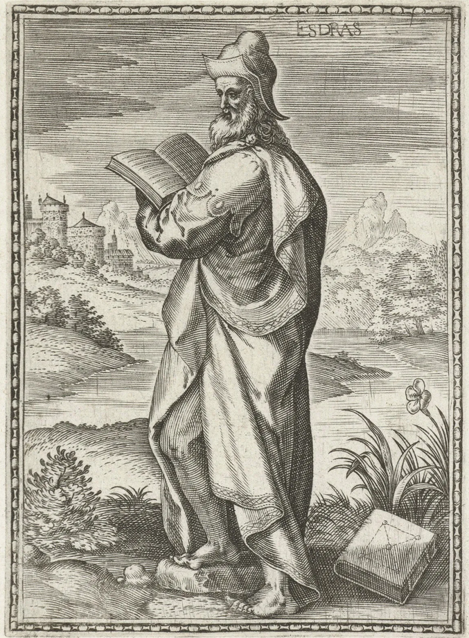
Ezra 7:28
“…and [God] has extended mercy to me before the king and his counselors, and before all the king's mighty princes. So I was encouraged, as the hand of the LORD my God was upon me; and I gathered leading men of Israel to go up with me.”

Slide 3
How The Hand Of The Lord Was Upon Ezra
In Receiving Requests From The King…
Ezra 7:6 “The king granted him all his request, according to the hand of the LORD his God upon him.”
Artaxerxes Allowed Him To:
Go to Jerusalem – Ezra 7:12,13
Take silver & gold to buy animals for sacrifice – Ezra 7:14-17
Buy what is needed for the service of the house of God- Ezra 7:18-23
Be free from taxation – Ezra 7:24
Set up magistrates & judges – Ezra 7:25,26
He recognized the hand of God was at work – Ezra 7:27,28

Slide 4
How The Hand Of The Lord Was Upon Ezra
In Finding Servants For The Temple….
Ezra 8:15 “found none of the sons of Levi there.”
Ezra 8:15-17 “that they should bring us servants for the house of our God.”
By the good hand of God upon them, they find 38 Levites and 220 Nethinim to assist them! - Ezra 8:18-20
In Providing Safe Journey To Jerusalem…
Ezra 8:21-23 – “we fasted and entreated our God for this, and He answered our prayer.”
God’s had was upon them, and they arrived in Jerusalem- Ezra 8:31,32

Slide 5
Why Was The Hand Of The Lord Was Upon Ezra?
Ezra Had Prepared Himself…
Ezra 7:9,10 God was with him:
“For (because) Ezra had prepared his heart...”
“to seek the Law of the Lord” (to learn what God wanted him to do)
“to do it” (to apply it to himself first)
“to teach statutes and ordinances in Israel” (and then teach others)
First made himself “useful for the Master, prepared for every good work” - 2 Timothy 2:21

Slide 6
Why Was The Hand Of The Lord Was Upon Ezra?
Ezra Had Sought The Lord…
Believed God would be with those who seek Him – Ezra 8:22
Entreated God through fasting & prayer - Ezra 8:21-23
Believed God Rewarded those who diligently seek Him- Hebrews 11:6
Ezra Was Willing To Step Out In Faith…
Ezra 8:31 “He delivered us from the hand of the enemy and from ambush along the road.”
Ezra demonstrated a living faith- James 2:17,26; Galatians 5:6

Slide 7
Why Was The Hand Of The Lord Was Upon Ezra?
Ezra Was Willing To Face Difficult Situations…
Ezra 9:1,2 Many of the Israelites had intermarried with Gentile women
Ezra 9:3-15 – “I tore my garment and my robe, and plucked out some of the hair of my head and beard, and sat down astonished”
Others joined him (“everyone who trembled at the words of the God of Israel”)
He accepted responsibility that was his – Ezra 10:1-8
Encouraged by those willing to repent
Leading the people to a great restoration!

Slide 8
The Hand Of The Lord Was Upon Ezra Because He:
Had prepared himself
Sought the Lord
Was willing to step out in faith
Was willing to face difficult situations

Slide 9
Ezra Was Not The Only Person Who The Hand Of The Lord Was Upon
Nehemiah 2:18 “the hand of my God which had been good upon me”
1 Samuel 5:6 “the hand of the LORD was heavy on the people of Ashdod”

Slide 10
How Will The Hand Of The Lord Be For Us?
For our good, if we emulate Ezra by:
Preparing ourselves to be useful to the Master! Seeking the Lord with diligence and faith! Stepping out in faith against the odds! Facing difficult issues and situations head on.
“The Hand Of The Lord My God Was Upon Me”

